Slide 1




IMPROVING AIR QUALITY TOGETHER
LIFE IP PrepAIR:
project’s achievements
and main results
31st May 2022
Emilia-Romagna Region
Delegation to the EU

Slide 2




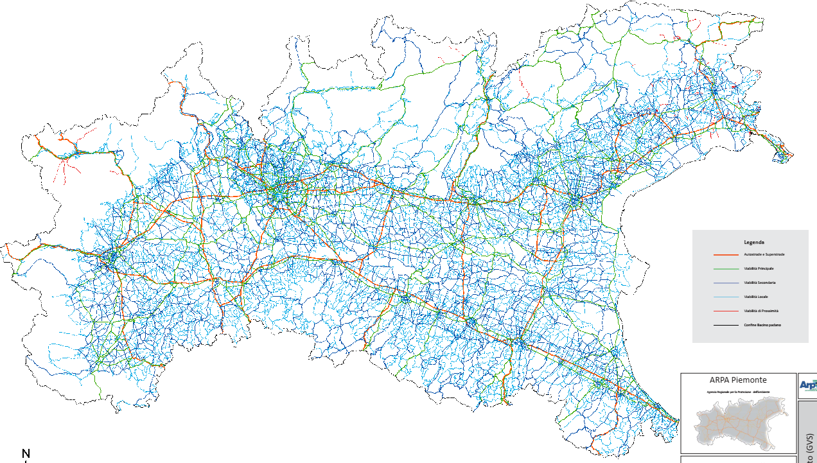
The study on traffic flows in the Po Valley
Francesca Bissardella, Stefania Ghigo
ARPA Piemonte

Slide 3
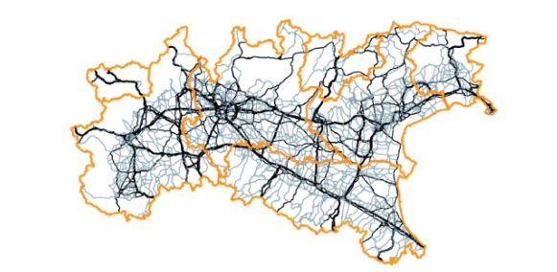
The study on traffic flows in the Po Valley
Application of a traffic model over the whole Po Basin, reconstructing vehicular flows on a common road network in order to quantify traffic emissions in the context of regional inventories

Slide 4
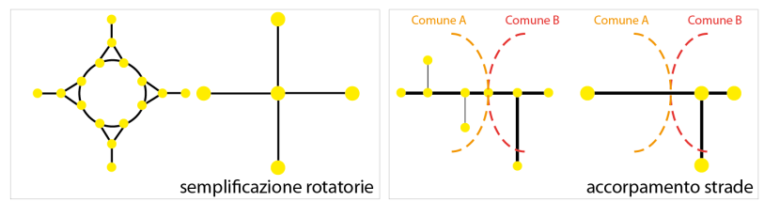
GRAPH & TRAFFIC DATA
The study on traffic flows in the Po Valley
Collected data and starting framework
1st STEP: Purchasing and simplification of a commercial traffic network graph by Tandem-Infoblu
Keeping only arcs with FUNC_CLASS from 1 to 4 and some arcs with FUNC_CLASS 5 belonging to Valle d’Aosta, Friuli Venezia Giulia and Trento ;
Making easier all roundabout, using only a center point (barycenter);
Joining consecutive arcs which are connected by a single node
roundabout simplification
consecutive arcs merging

Slide 5
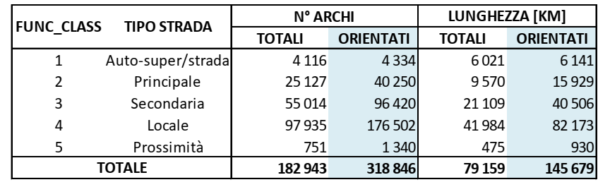
GRAPH & TRAFFIC DATA
The study on traffic flows in the Po Valley
Collected data and starting framework

Slide 6
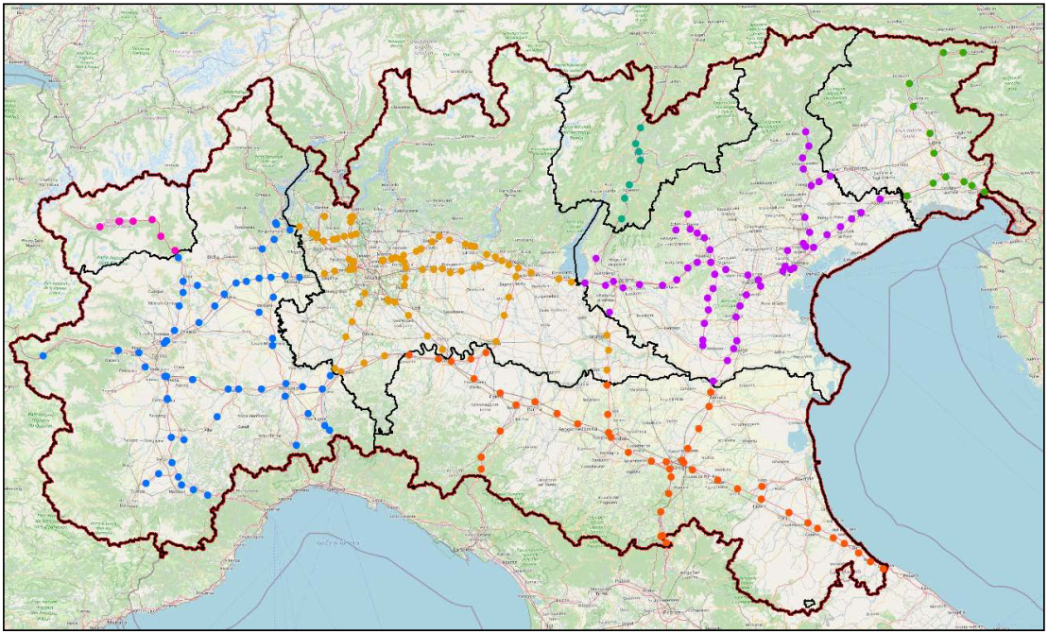
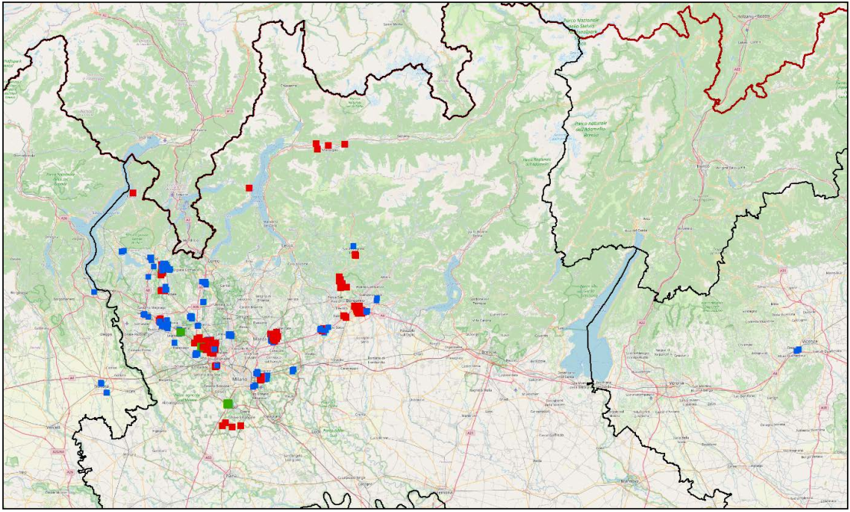
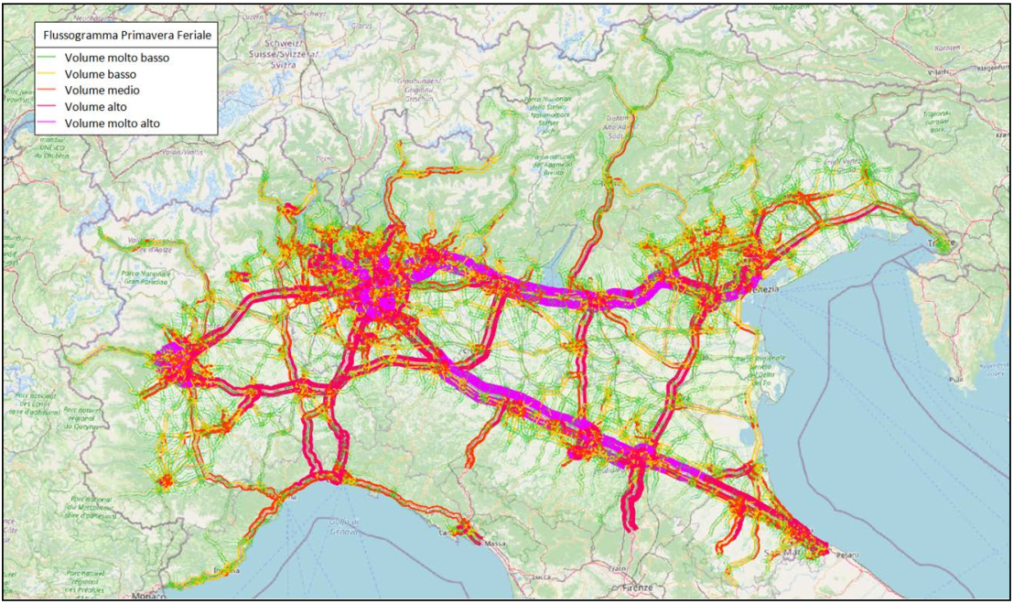
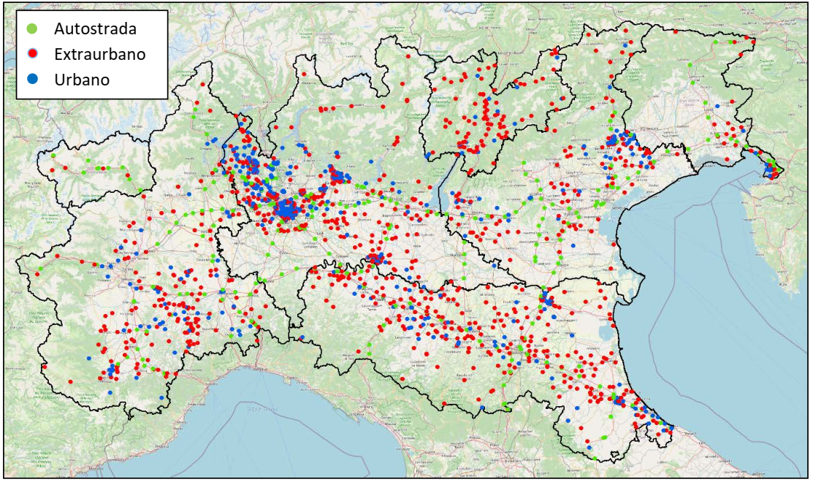
GRAPH & TRAFFIC DATA
The study on traffic flows in the Po Valley
2nd STEP: Traffic flow data entry (year 2019)
HIGHWAY AND TELEPASS DATA
TANDEM – INFOBLU DATA
FCD (Floating Car Data)
DATA FROM PUBLIC AUTHORITY

Slide 7
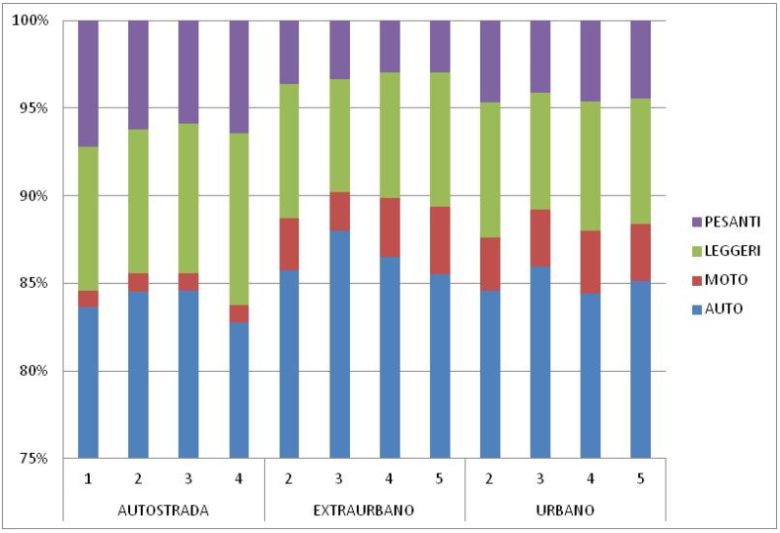
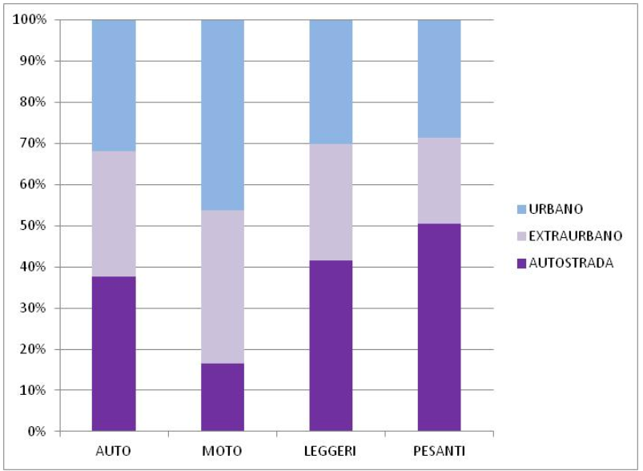
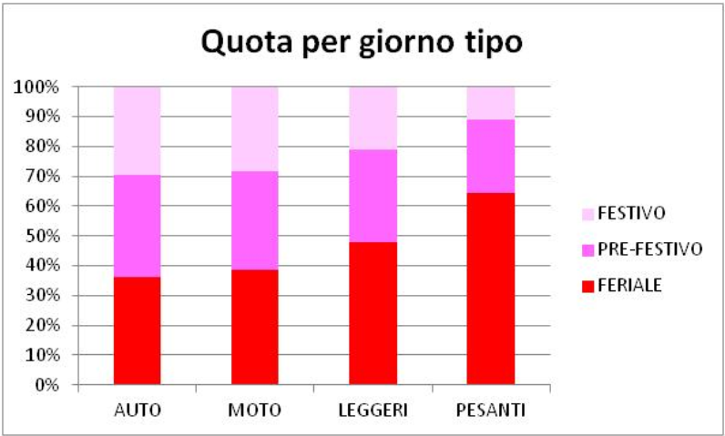
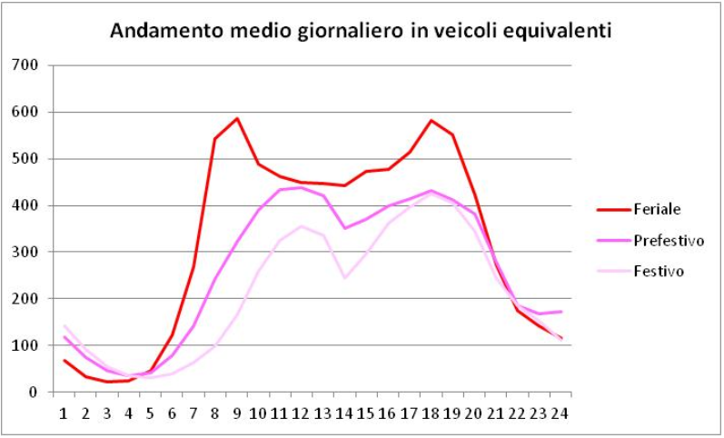
TRAFFIC FLOWS
The study on traffic flows in the Po Valley
Dataset (metadata and results) of traffic flows
assigned on common graph of road network
Vehicle types / funclass / road types
Vehicle types / road types
After a traffic flow data «correction process», Tandem-Infoblu introduced these corrected traffic flow data as input to WILLUMSEN model.
Vehicle types / day types
Daily average trend of traffic flows

Slide 8
TRAFFIC FLOWS
The study on traffic flows in the Po Valley
Methodology in estimating traffic flow
Model simulations were conducted using WILLUMSEN's model.
It is a model that estimates the O/D matrices starting from the traffic flows and is based on the principle of entropy: among all the O/D matrices that satisfy the traffic flow counts, the optimal one maximizes the entropy of movements.
48 simulations were required and developed for this project, each relating to the 4 vehicular classes for the following situations:
Season (winter, spring, summer, autumn)
Day type (weekday, Saturday, holiday)
Time slot (morning, day, evening, night), distributed throughout the day as follows:
- Morning: from 7:00 to 9:00;
- Day: from 10:00 to 16:00;
- Evening: from 17:00 to 20:00;
- Night: from 21:00 to 6:00.

Slide 9
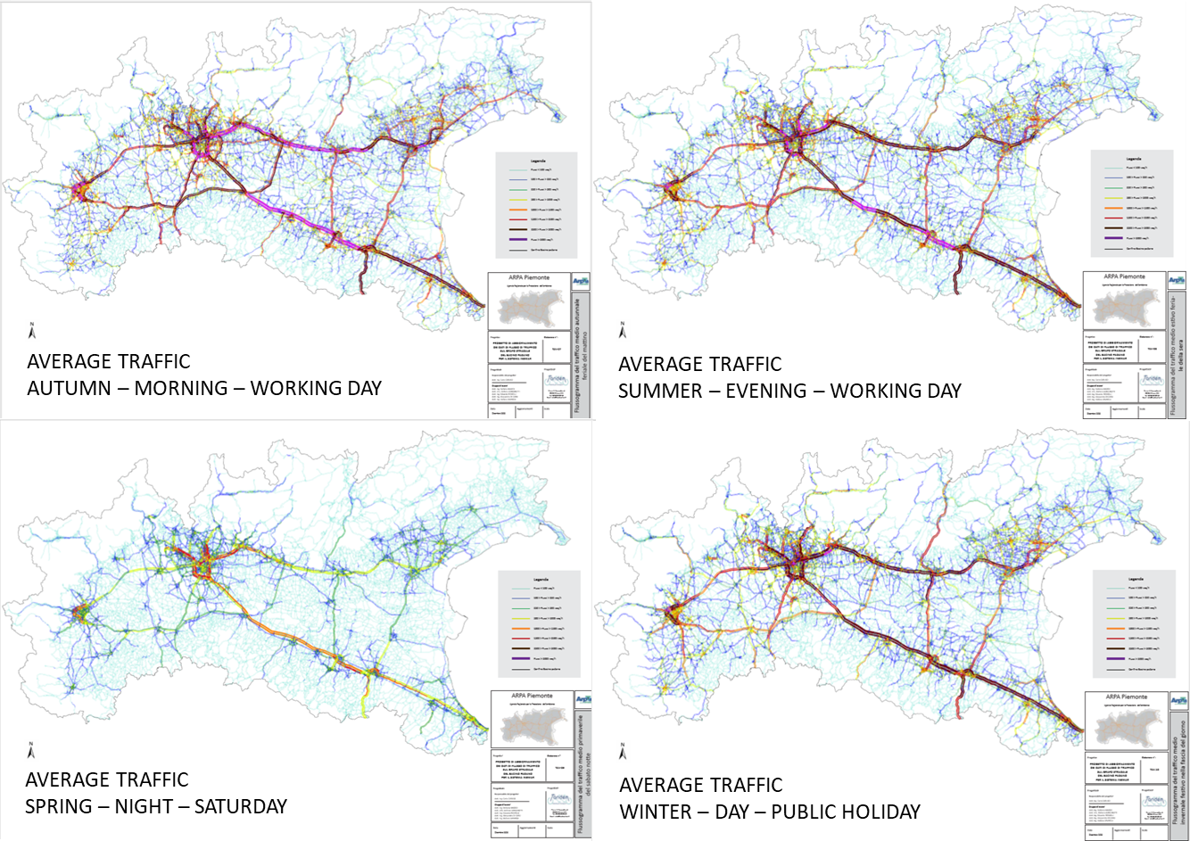
TRAFFIC FLOWS
The study on traffic flows in the Po Valley
Some results

Slide 10
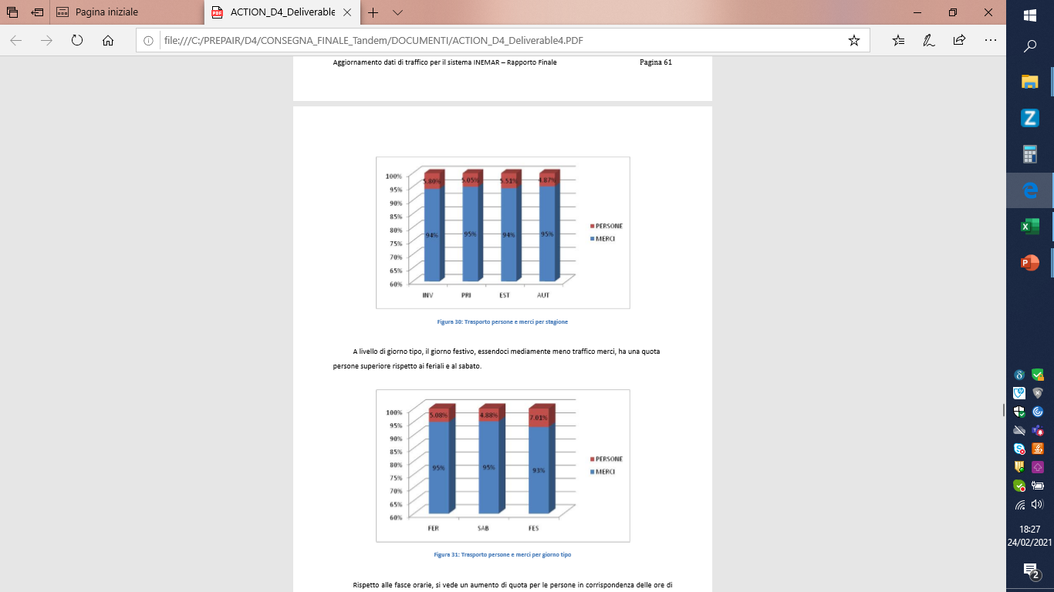
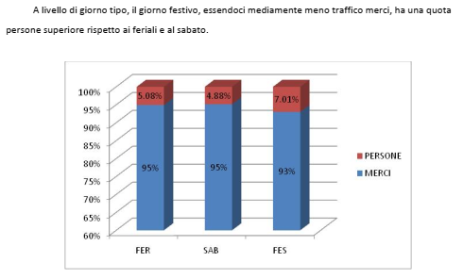
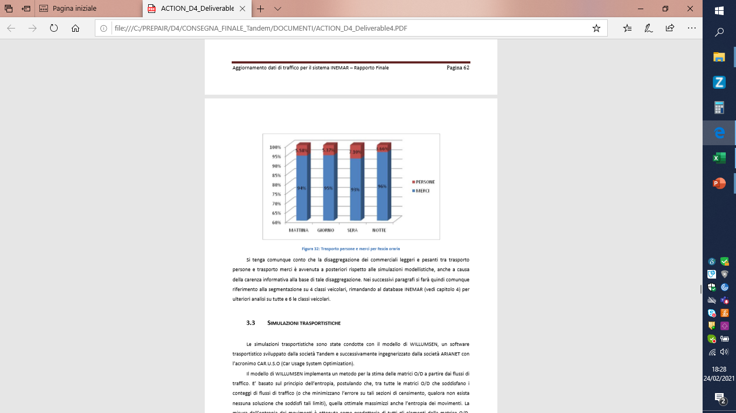
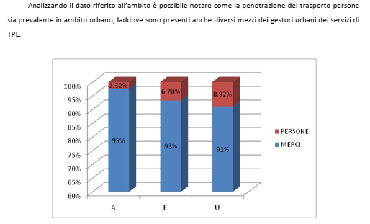
TRAFFIC FLOWS – FOCUS ON GOODS
The study on traffic flows in the Po Valley
FOCUS: light and heavy-duty vehicles segmentation
by passenger and goods transport
This activity was done on the model output and the two vehicle classes HDV and LDV were split into :
LDV, passenger transport
HDV, passenger transport
LDV, goods transport
HDV, goods transport
SEASONS
DAY TYPES
TIME SLOTS
ROAD TYPES

Slide 11
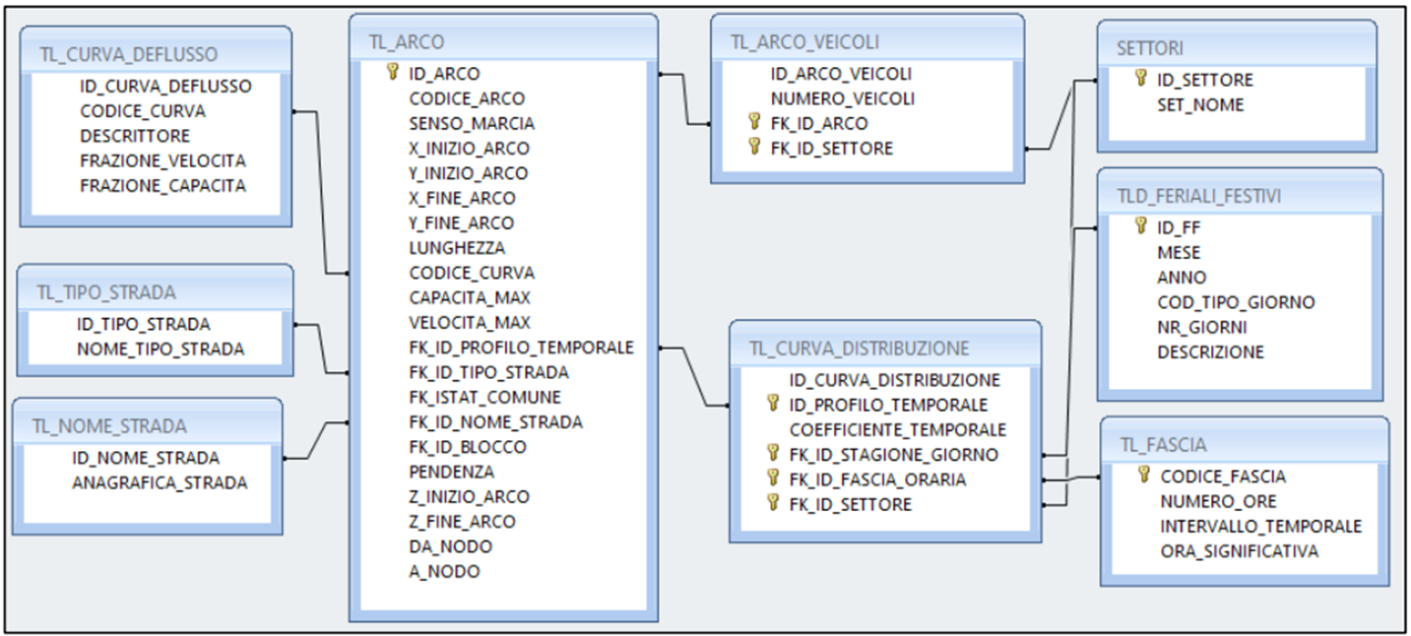
INEMAR INPUT
The study on traffic flows in the Po Valley
INEMAR
All the attributes of the graph were then translated into the table format requested in input by INEMAR model

Slide 12
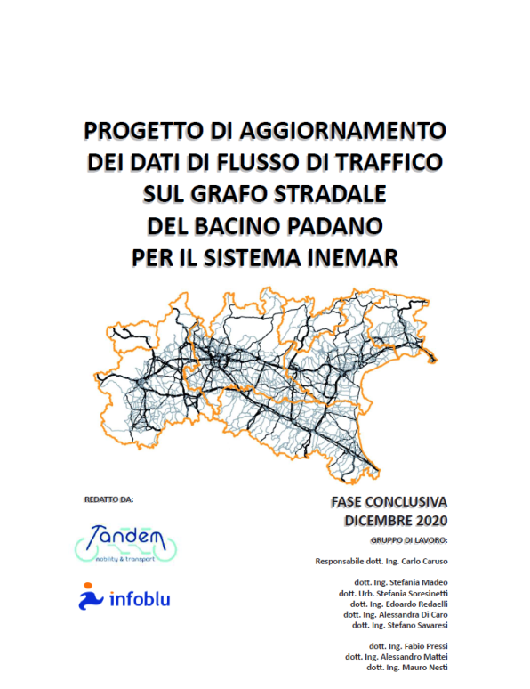
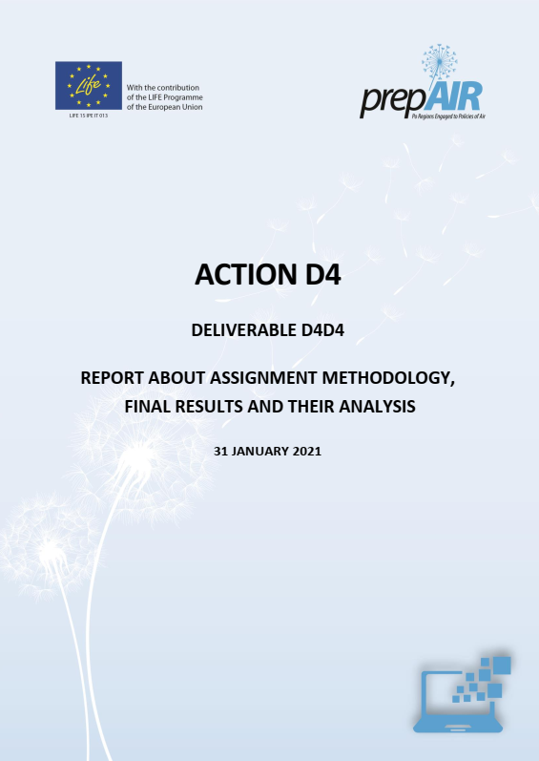
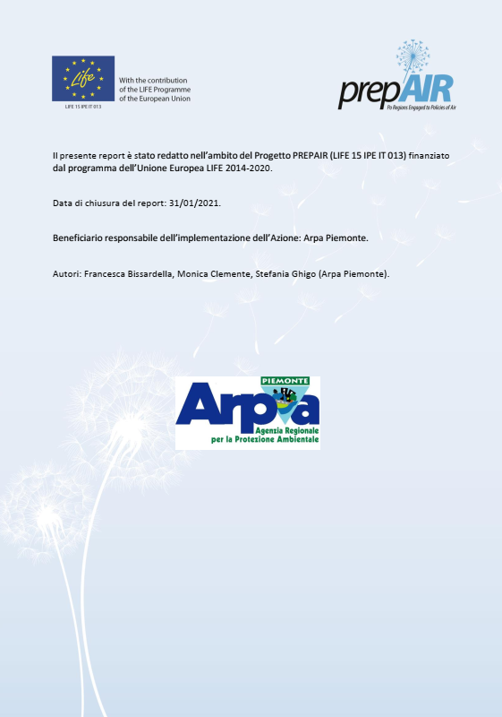
The study on traffic flows in the Po Valley
REPORT
All the work done was collected and described in a Tandem-Infoblu document and also in the ARPA Piemonte report

Slide 13
UPDATING
The study on traffic flows in the Po Valley
Traffic flow updating
Year of traffic flow dataset updating chosen: 2021
Applications for traffic data to the PUBLIC AUTHORITIES and MOTORWAY COMPANIES is over.
Useful data are those relating to the year of interest.

Slide 14


www.lifeprepair.eu - info@lifeprepair.ue

